Slide 1



Slide 2



01CE0410 – Computer Network
Unit - 3
Transport Layer
Prof. Megha Mudholkar
Computer Engineering Department

Slide 3
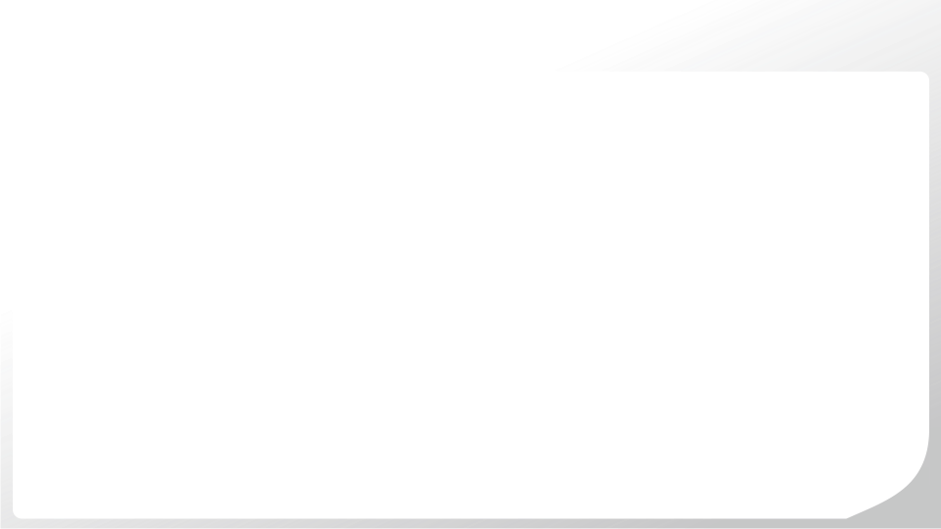
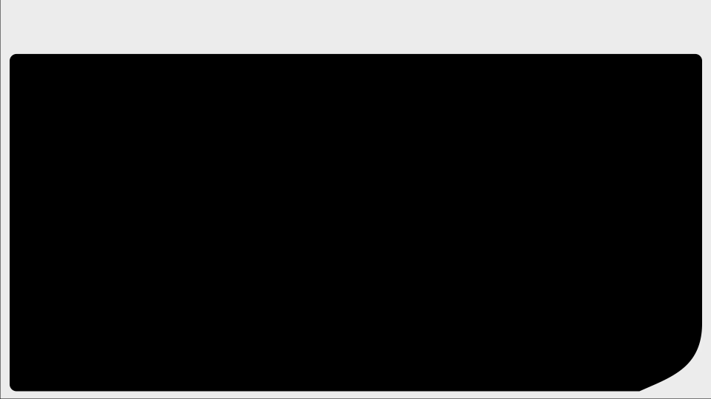
Outline
Introduction to transport layer and its services
Transport Layer Protocol: TCP and UDP
Principle of Reliable Data Transfer
Noisy and Noiseless Channel Protocol: Go back N and Selective Repeat Protocol
Flow Control
Congestion Control

Slide 4

Introduction to Transport Layer & its Services

Slide 5
Introduction to Transport Layer
The transport layer provide data transport from a process on a source machine to a process on a destination machine with a desired level of reliability that is independent of the physical networks currently in use. It provides the abstractions that applications need to use the network.
A transport layer protocol provides support for logical communication between application processes running on different hosts.
Transport layer protocols are implemented in the end system not in network router.
All transport layer protocols provide an application multiplexing/demultiplexing service.
The data communicated by the transport layer is encapsulated in a transport layer PDU and sent in a network layer PDU.
The network layer nodes transfer the transport PDU intact, without decoding or modifying the content of the PDU.
The transport layer is responsible for reliable data delivery.
A upper-layer protocols depends heavily on the transport layer protocol.

Slide 6
Introduction to Transport Layer
A high level of error recovery is also provided in this layer.
This layer ensures, that packets are delivered error free, in sequence and with no losses or duplications.
Transport layer requires transport layer address called a port number for selecting among multiple processes running on the destination host.
The Internet Assigned Number Authority (IANA) has divided the port number into three ranges. They are
No. | Port Type | Range | Remarks
1 | Well Known Port | 0 to 1023 | Assigned and controlled by IANA
2 | Registered Port | 1024 to 49151 | Not assigned and controlled by IANA. Only registered to prevent duplication
3 | Dynamic | 49152 to 65535 | Neither controlled nor registered. Used by any process.

Slide 7
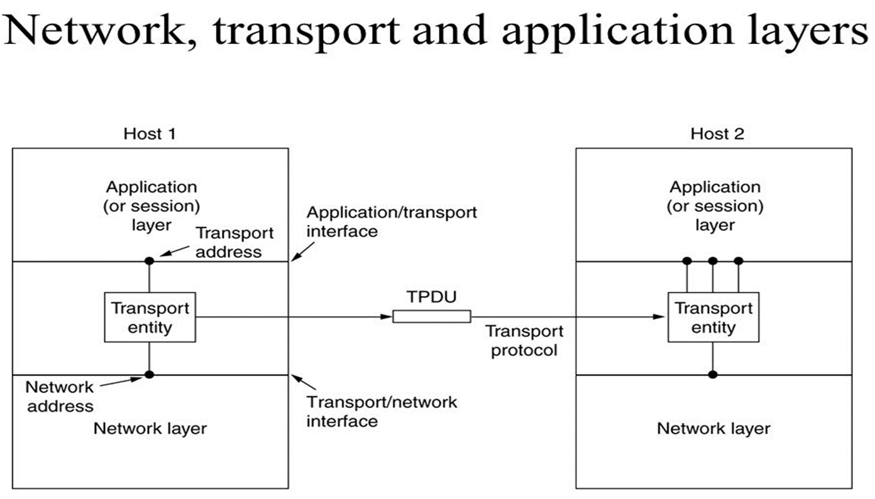
Service of Transport Layer
The transport entity provides services to transport services users, which might be an application process.
The hardware and software within the transport layer that does the work is called the transport layer entity.
The relationship of the network, transport and application layer shown in figure.

Slide 8
Service of Transport Layer
The following categories of services are useful for describing the transport service.
Type of service
Quality of service
Data Transfer
User Interface
Connection management
Status reporting
Security

Slide 9
Service of Transport Layer
Types of service
It provides two types of services connection-oriented and connectionless.
A connection-oriented service provides for the establishment, maintenance and termination of a logical connection between transport service users.
The connection-oriented allows features such as flow control, error control and reliable delivery.
Quality of service
The transport protocol entity should allow the transport service user to specify the quality of transmission service to be provided. Following are the transport layer quality of services parameter:
Error and loss levels
Desired average and maximum delay
Throughput
Priority level
Quickly recover from difficulties
Notes:
Throughput: is a measure of how many units of information a system can process in a given amount of time.

Slide 10
Service of Transport Layer
Data Transfer
It transfers data between two transport entities.
Both user data and control data must be transferred.
Full duplex service must be provided.
Half-duplex and simplex modes may also be offered.
User Interface
There is not clear mechanism of the user interface to transport protocol. It should be standardized.
Connection Management
If connection-oriented service is provided, the transport entity is responsible for establishing and terminating connections.

Slide 11
Service of Transport Layer
Status Reporting
It gives the following information:
Addresses
Performance characteristics of a connection
Class of protocol in use
Current timer values
Security
The transport entity may provide a variety of security services. It provides encryption and decryption of data. The entity may be capable of routing through secure links or nodes if such a service is available from transmission facility.

Slide 12
Transport Layer Protocol: TCP
Phases of TCP
Multiplexing & Demultiplexing
TCP Header

Slide 13
TCP (Transmission Control Protocol)
TCP stands for Transmission Control Protocol.
TCP is connection oriented protocol.
Connection establishment is virtual connection between sender and receiver.
There are 3 phases in any virtual connection. These are the connection establishment, data transfer and connection termination phases.
In order for two hosts to communicate using TCP they must first establish a connection by exchanging messages in what is known as the 3-way handshake.

Slide 14
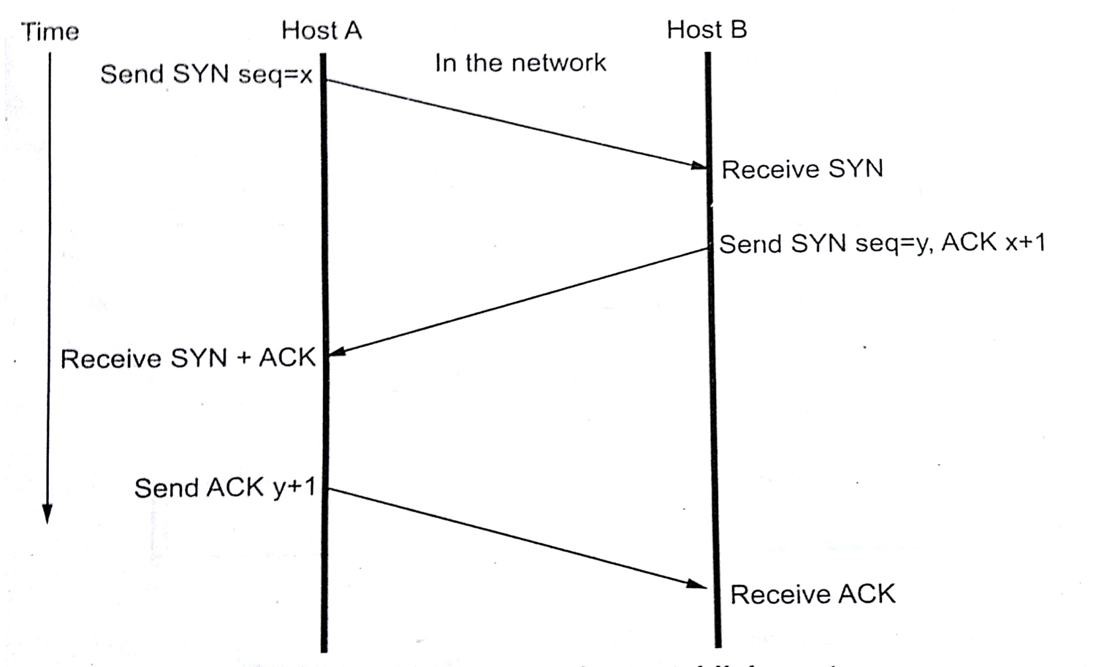
TCP (Transmission Control Protocol)
Connection Establishment
Figure shows the process of three way handshake.
From figure it can be seen that there are 3 TCP segments exchanged between two hosts, host A and host B.
To start, host A initiates the connection by sending a TCP segment with the SYN control bit set and an Initial Sequence Number (ISN) here it is represented as the variable x in the sequence number field.

Slide 15
TCP (Transmission Control Protocol)
After sometime, host B receives this SYN segment, process it and responds with a TCP segment of its own.
The response from host B contains SYN control bit set and its own ISN represented as y.
Host B also sets ACK control bit to indicate the next expected byte from host A should contain data starting with sequence number x+1.

Slide 16
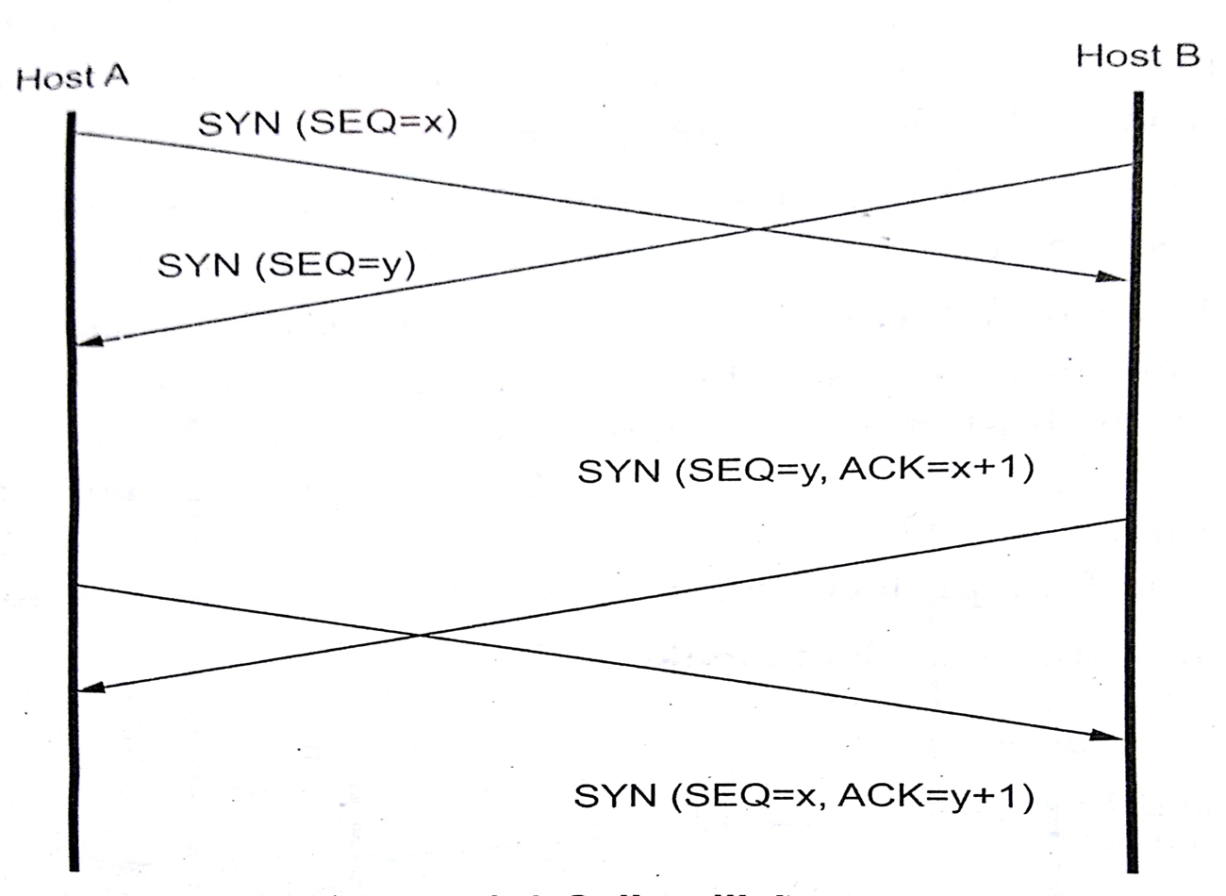
TCP (Transmission Control Protocol)
Connection Establishment (Collision Case)
If the two host simultaneously attempt to establish a connection between the same sockets, the sequence of events is shown in figure.
Only one connection is established, not two because connections are identified by their end points.

Slide 17
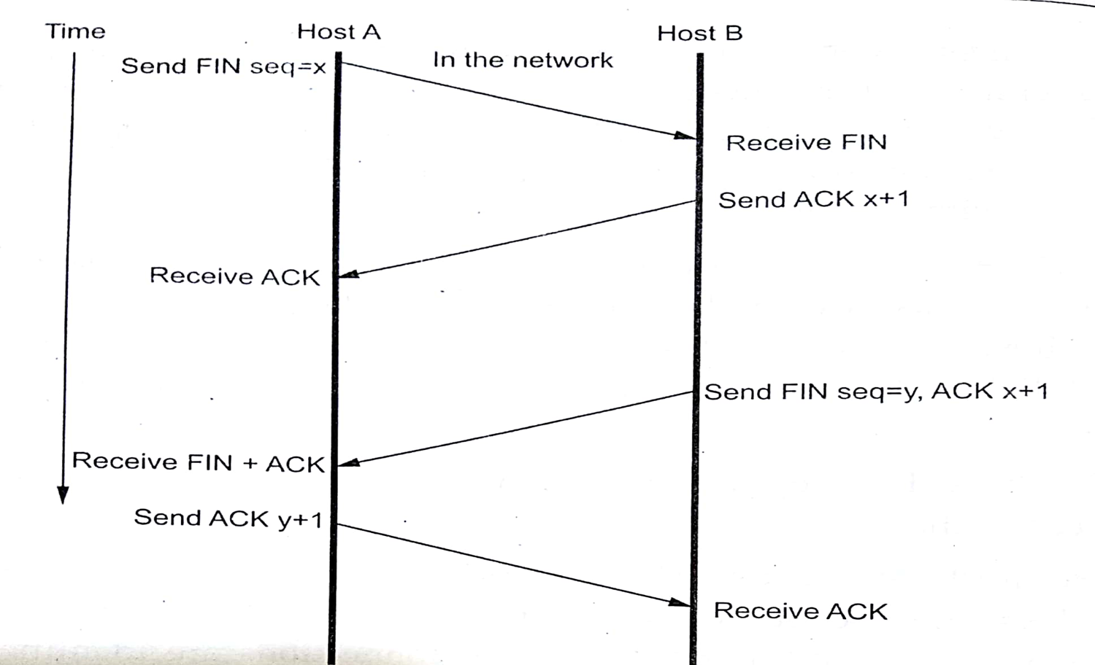
TCP (Transmission Control Protocol)
Connection Termination
In order for a connection to be released, four segments are required to completely close a connection.
Four segments are necessary due to the fact that TCP is full-duplex protocol, meaning that each end must shut down independently.
The connection termination phase is shown in figure.
Notice that instead of SYN control bit, the connection termination phase uses the FIN control bit to signal the close of a connection.
To terminate the connection, the application running on host A signals TCP to close the connection.

Slide 18
TCP (Transmission Control Protocol)
Connection Termination
This generates the first FIN segment from host A to host B.
When host B receives initial FIN segment, it immediately acknowledges the segment and notifies its destination application of the termination request.
Once the application on host B also decide to shut down the connection, it then sends its own FIN segment, which host A will process and respond with an acknowledgement.
There are four different scenarios for terminating connection.

Slide 19
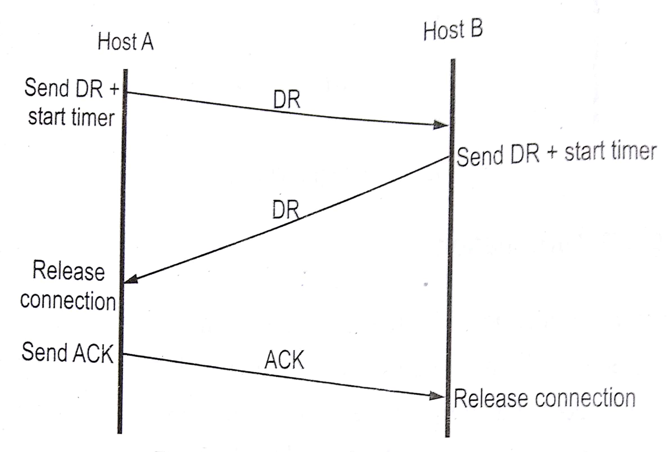
TCP (Transmission Control Protocol)
Connection Termination (Normal case of 3-way Handshake)
One of the user sends a DR (Disconnected request) TPDU to initiate the connection release.
When it arrives, the receipt sends back and DR TPDU and start a timer.
When this DR arrives, the original sender sends back an ACK TPDU and releases the connection.
Finally, when the ACK TPDU arrives, the receiver also releases the connection.

Slide 20
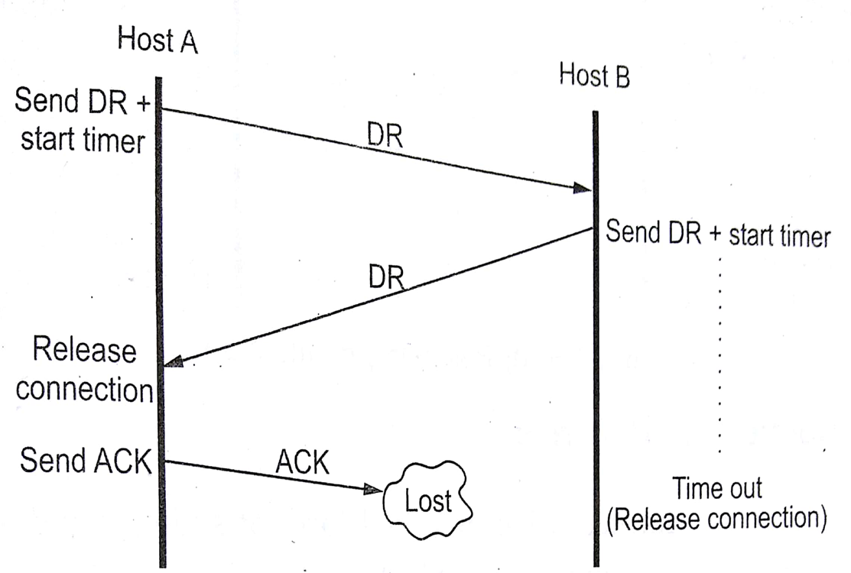
TCP (Transmission Control Protocol)
Connection Termination (Final Ack lost)
If the final ACK is lost, the situation is save by the timer. When the timer expires, the connection released anyway.

Slide 21
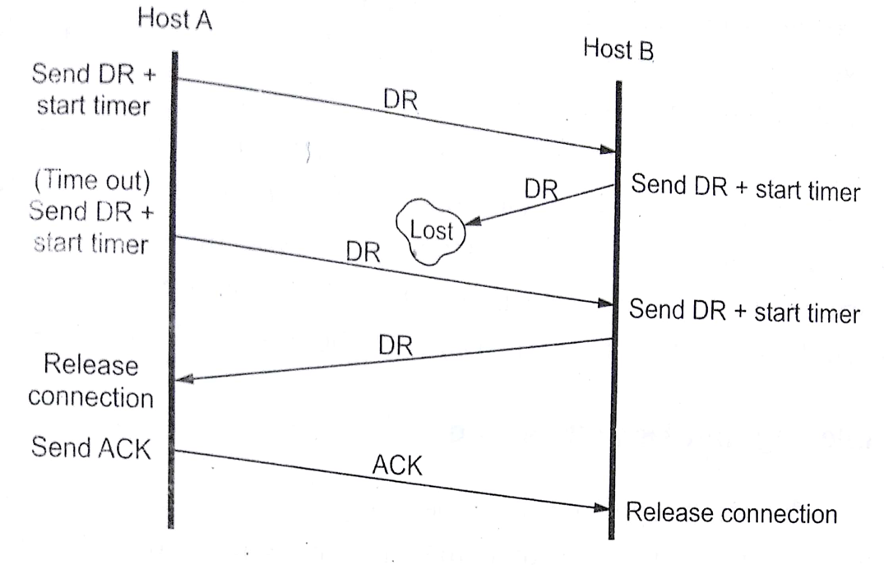
TCP (Transmission Control Protocol)
Connection Termination (Response lost)
If the second DR lost then the user initiating the disconnection will not receive the expected response, will time out. The second time no TPDU are lost and all TPDU are delivered correctly on time.

Slide 22
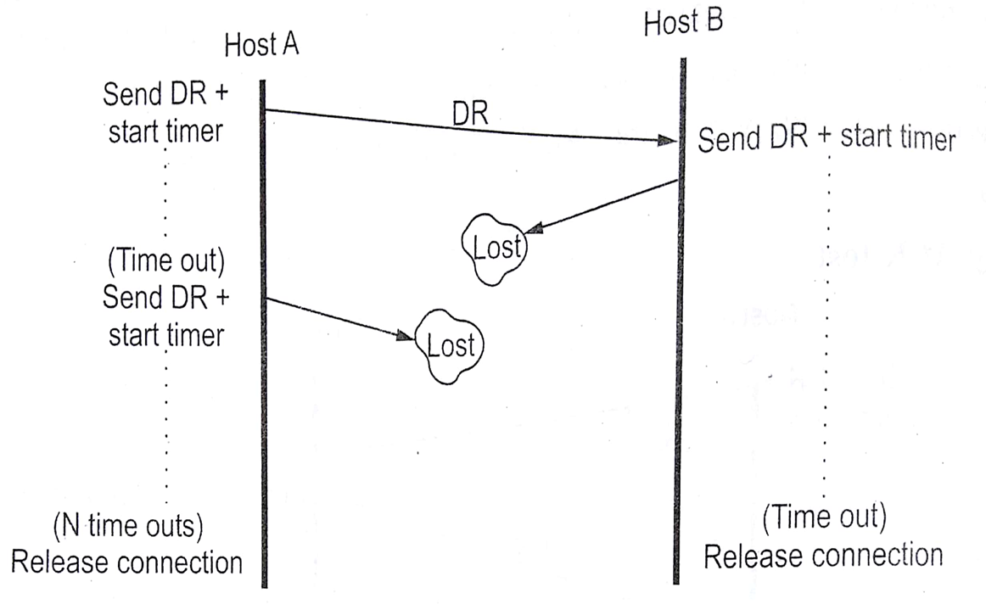
TCP (Transmission Control Protocol)
Connection Termination (Response lost and subsequent DR lost)
If host A sends DR, it receives by host B. Then host B sends DR, it lost. Again host A sends subsequent DR, it also lost. After time session expires connection automatically terminated.

Slide 23
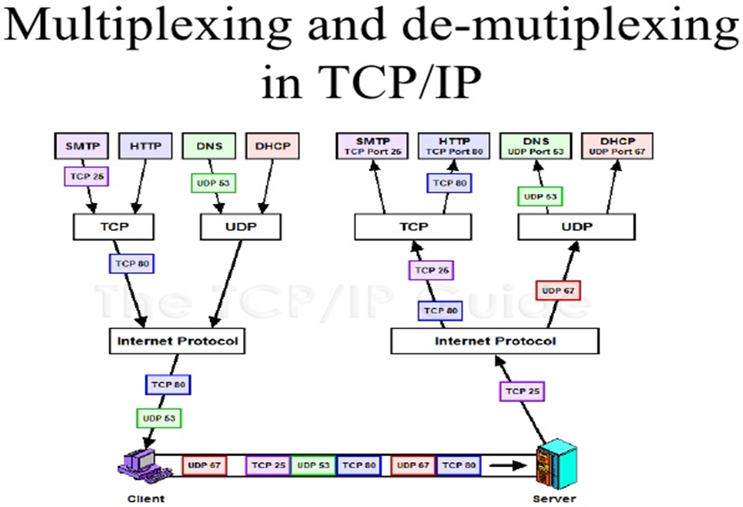
TCP (Transmission Control Protocol)
Multiplexing & Demultiplexing
UDP and TCP perform the demultiplexing and multiplexing jobs by including two special fields in the segment headers: the source port number field and the destination port number field.
Multiplexing: Gathering data from multiple application processes of the sender, enveloping that data with a header, and sending them as a whole to the intended receiver is called multiplexing.
Demultiplexing: Delivering received segments at the receiver side to the correct app layer processes is called demultiplexing.

Slide 24
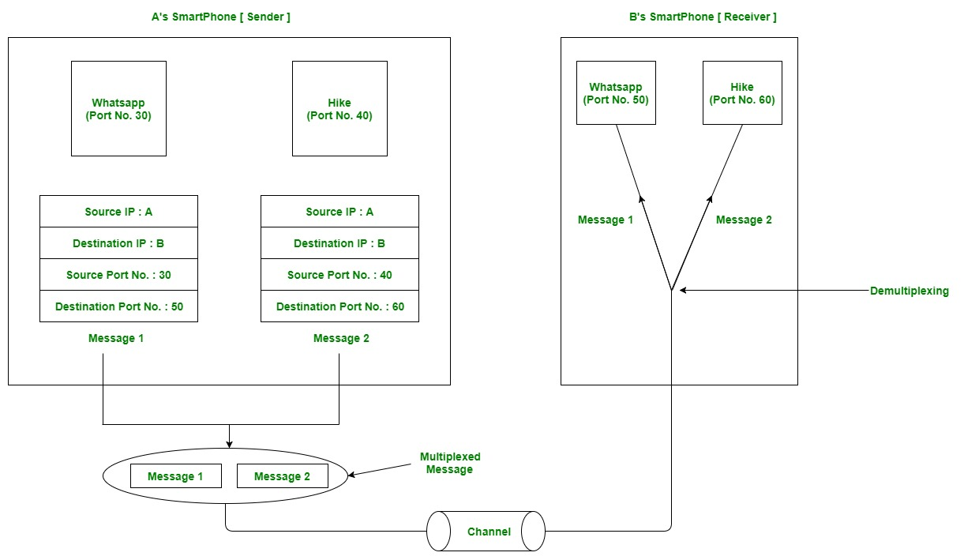
TCP (Transmission Control Protocol)
Example of Multiplexing
& Demultiplexing

Slide 25
TCP (Transmission Control Protocol)
Example of Multiplexing & Demultiplexing
Let us consider two messaging apps that are widely used nowadays viz. Hike and WhatsApp. Suppose A is the sender and B is the receiver. Both sender and receiver have these applications installed in their system (say smartphone).
Suppose A wants to send messages to B in WhatsApp and hike both. In order to do so, A must mention the IP address of B and destination port number of the WhatsApp while sending the message through the WhatsApp application. Similarly, for the latter case, A must mention the IP address of B and the destination port number of the hike while sending the message.
Now the messages from both the apps will be wrapped up along with appropriate headers(viz. source IP address, destination IP address, source port no, destination port number) and sent as a single message to the receiver. This process is called multiplexing. At the destination, the received message is unwrapped and sent to the appropriate application by looking to the destination the port number.
This process is called demultiplexing.
Similarly, B can also transfer the messages to A.

Slide 26
TCP (Transmission Control Protocol)
Connectionless Multiplexing & Demultiplexing
UDP socket is identified by two-segment:
Destination IP address
Destination port number
Connection-Oriented Multiplexing & Demultiplexing
TCP socket is identified by four segment:
Source IP address
Source port number
Destination IP address
Destination port number

Slide 27
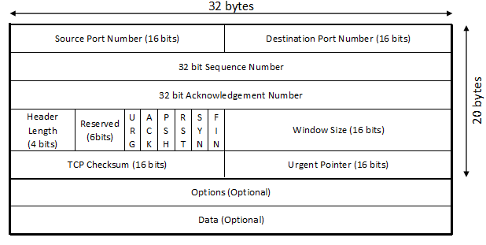
TCP (Transmission Control Protocol)
TCP Header (TCP Segment Structure)

Slide 28
TCP (Transmission Control Protocol)
TCP Header
Figure shows the format of the TCP header. It’s also called TCP segment structure.
Source Port: It specifies the application sending the segment. This is different from the IP address, which specifies an internet address.
Destination Port: It defines the receiving application port numbers below 1023 called well-known ports are assigned to commonly used application.
Sequence Number: Each byte in the stream that TCP sends is numbered. It is used to arrange all packets in a sequence at destination side.
Acknowledgement Number: This field identifies the sequence number of the next data by that the sender expects to receive if the ACK bit is set.

Slide 29
TCP (Transmission Control Protocol)
TCP Header
Header Length: It tells how many 32 bits words are contained in the TCP header.
Reserved: This field is reserved for future use and must be set to 0.
There are 6 flags in TCP header: URG, ACK, PSH, RST, SYN, FIN.
URG: The urgent pointer is valid if it set to 1.
ACK: ACK bit is set to 1 to indicate the acknowledgement number valid.
PSH: The receiver should pass this data to the application as soon as possible.
RST: This flag is used to reset the connection. It is also used to reject an invalid segment.

Slide 30
TCP (Transmission Control Protocol)
TCP Header
SYN: Synchronization sequence number to initiate a connection. The connection SYN = 1and ACK =0.
FIN: The FIN bit is used to release a connection. It specifies that the sender is finished sending data.
Window Size: It specifies the number of bytes the receiver is willing to accept. This field can be used to control the flow of data and congestion.
Checksum: Used for transport layer error detection.
Urgent Pointer: If the URG flag bit is set, the segment contains urgent data meaning the receiving TCP entity must deliver it to the higher layers immediately.
Bits
bits

Slide 31
TCP (Transmission Control Protocol)
TCP Header
Options: Size of this field is variable option field may be used to provide other functions that are not covered by the header.
Data: Data field size is variable. It contains user data.
bits

Slide 32
TCP (Transmission Control Protocol)
Realtime Application of TCP
Chatting Application (Text Communication) – WhatsApp, Instagram, Google hangouts, Telegram, iMessage, FB Messenger
FTP (File Transfer Protocol) – FileZilla, Smart FTP, Core FTP, Fire FTP, Cyber duck and many more.
HTTP (Hyper Text Transfer Protocol) – HTTP uses TCP to access the webpages from internet. Ex., Website on internet. Facebook, Instagram etc…
SMTP (Simple Mail Transfer Protocol) – SMTP is an application layer protocol. It uses TCP protocol service to communicate with SMTP server. First of all, SMTP server accept connection request and then it allows the user to send mail. Ex., Yahoo mail, Gmail, Outlook, Rediff mail.

Slide 33
Transport Layer Protocol: UDP
UDP Header
Checksum Example
UDP Example
UDP Realtime Application

Slide 34
UDP (User Datagram Protocol)
UDP stands for User Datagram Protocol.
UDP is a simple, datagram-oriented transport layer protocol.
This protocol used in place of TCP. UDP is connectionless protocol provides no reliability or flow control mechanisms.
It also has no error recovery procedures.
Several application layer protocols such as TFTP, DNS and RPC use UDP.
UDP makes use of the port concept to direct datagrams to the proper upper-layer applications.
UDP serves as a simple application interface to the IP.

Slide 35
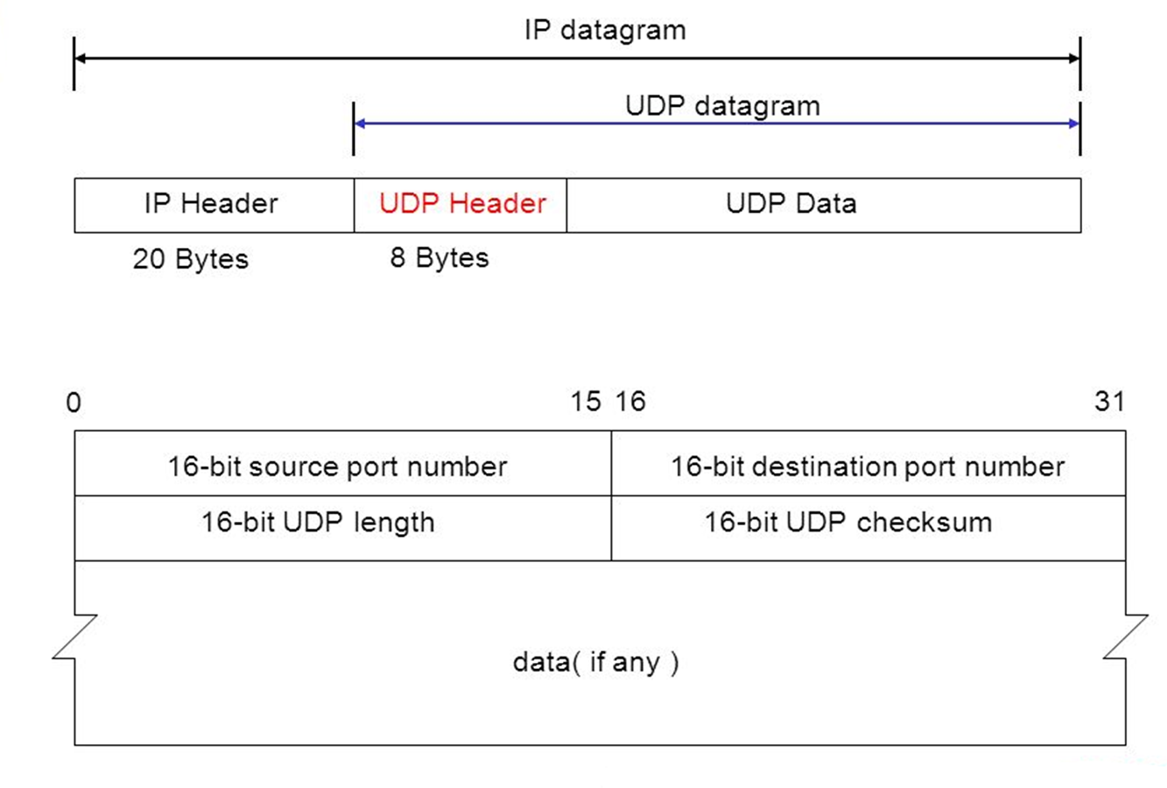
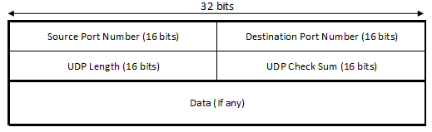
UDP (User Datagram Protocol)
UDP Header
Above figure shows the encapsulation of a UDP datagram as an IP datagram.
Above figure shows the format of the UDP header. The port number identify the sending process and the receiving process.

Slide 36
UDP (User Datagram Protocol)
UDP Header
Source Port: Source port number identifies the port of the sending application process.
Destination Port: Destination port number identifies the receiving process on the destination host machine.
UDP Length: The UDP length field is the length of the UDP data in bytes. The minimum value for this field is 8 bytes.
UDP Checksum: UDP checksum covers the UDP header and the UDP data. Both UDP and TCP include a pseudo-header with the UDP datagram just for the checksum calculations.
Data: Data field size is variable. It contains user data.

Slide 37
UDP (User Datagram Protocol)
UDP Checksum
UDP checksum calculate from UDP header and UDP datagram part.
Purpose of UDP header is check error in datagram.
First of all, at sender side checksum has been calculated and checksum value added in checksum field.
Again, checksum is calculated at receiver end, if there is mismatch in both the value, then datagram must be discarded by receiver, because no error recovery in UDP datagram.
But in some of the application packet is pass to that application with warning.

Slide 38
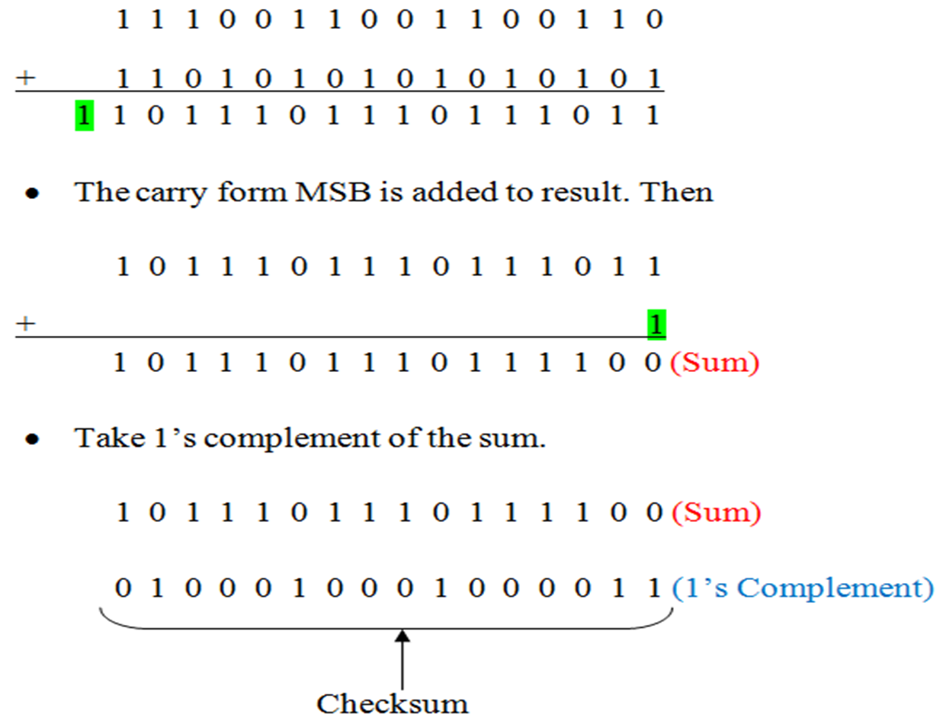
UDP (User Datagram Protocol)
Example of UDP Checksum

Slide 39
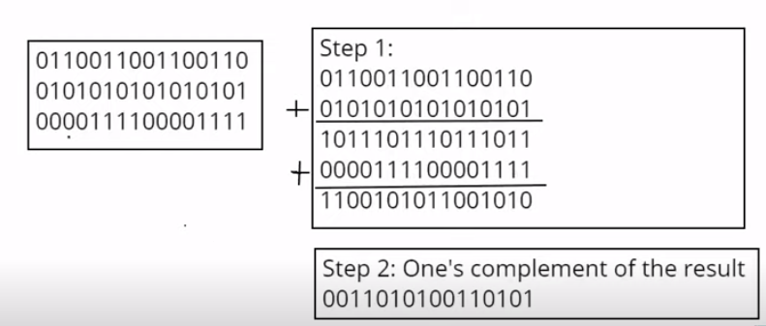
UDP (User Datagram Protocol)
Example of UDP Checksum

Slide 40
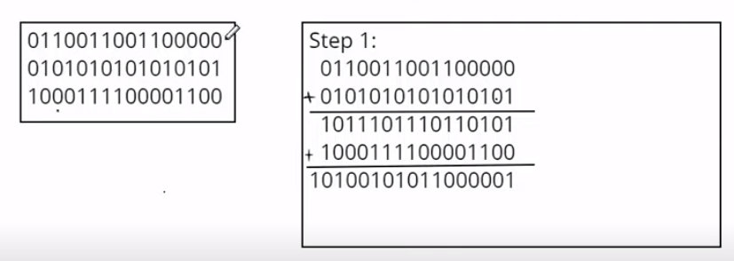
UDP (User Datagram Protocol)
Example of UDP Checksum

Slide 41
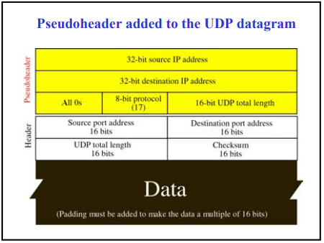
UDP (User Datagram Protocol)
Example of UDP Checksum

Slide 42
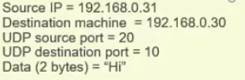
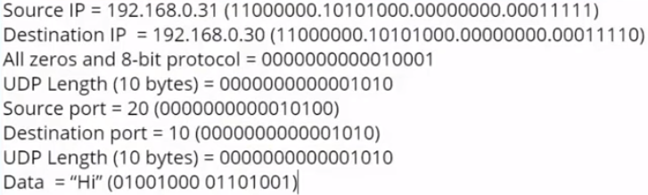
UDP (User Datagram Protocol)
Example of UDP Checksum

Slide 43
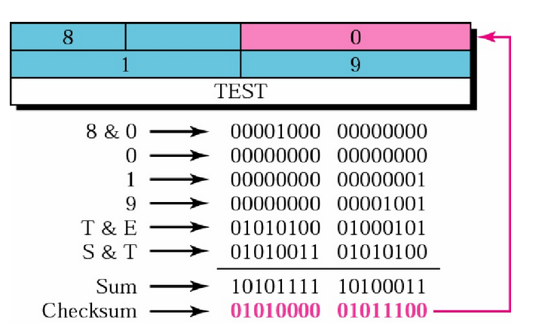
UDP (User Datagram Protocol)
Example of UDP Checksum
E - 69
S - 83
T - 84
E - 01000101
S - 01010011
T - 01010100
1’s Complement

Slide 44
UDP (User Datagram Protocol)
Example of UDP
The following is a dump of a UDP header in hexadecimal format.
CB84000D001C001C
What is the source port number?
What is the destination port number?
What is the total length of the user datagram?
What is the length of the data?

Slide 45
UDP (User Datagram Protocol)
Example of UDP
The following is a dump of a UDP header in hexadecimal format.
CB84000D001C001C
What is the source port number?- The source port number is the first four hexadecimal digits (CB84), which means that the source port number is 52100.
What is the destination port number?- The destination port number is the second four hexadecimal digits (000D), which means that the destination port number is 13.
What is the total length of the user datagram?- The third four hexadecimal digits (001C) define the length of the whole UDP packet as 28 bytes.
What is the length of the data?- The length of the data is the length of the whole packet minus the length of the header, or 28 – 8 = 20 bytes.

Slide 46
UDP (User Datagram Protocol)
Realtime Application of UDP
Broadcasting and multicasting applications use UDP protocols.
Streaming media applications such as movies.
Online multiplayer games.
Voice over Internet Protocol (VoIP).
UDP is used with the RTOS (real time operating systems).
UDP is used in aircraft controls and flight instruments.
DNS uses UDP protocol, because immediate response is required in DNS.

Slide 47
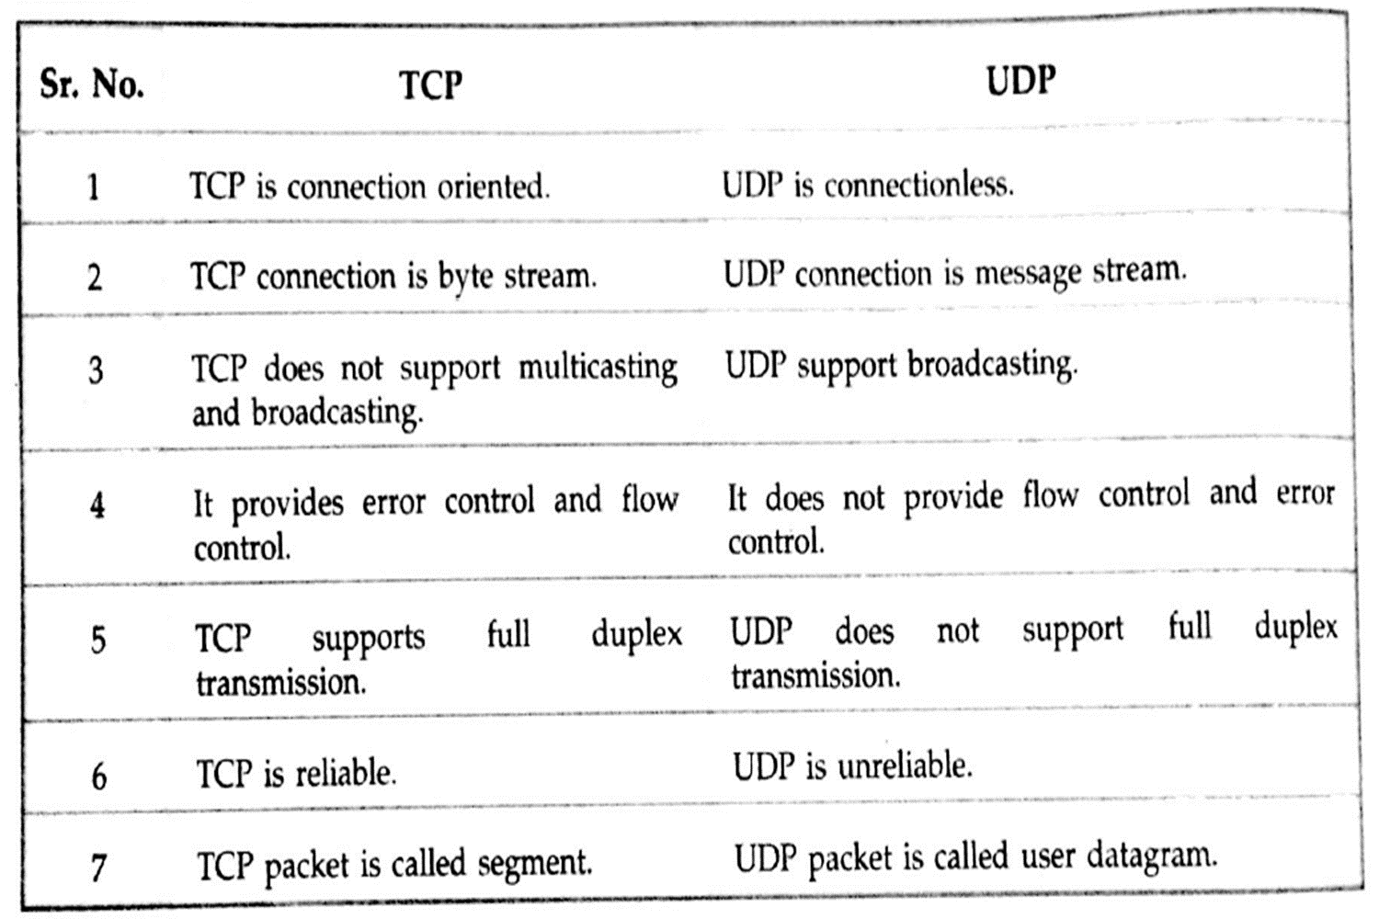
Difference between TCP and UDP

Slide 48
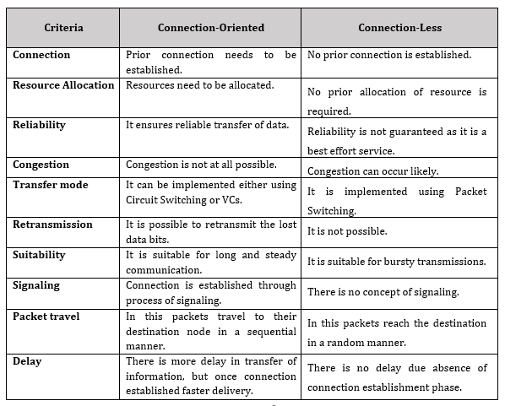
Connection Oriented vs Connection Less

Slide 49
Principle of Reliable Data Transfer
rdt 2.0 model
Noisy and Noiseless Channel Protocol

Slide 50
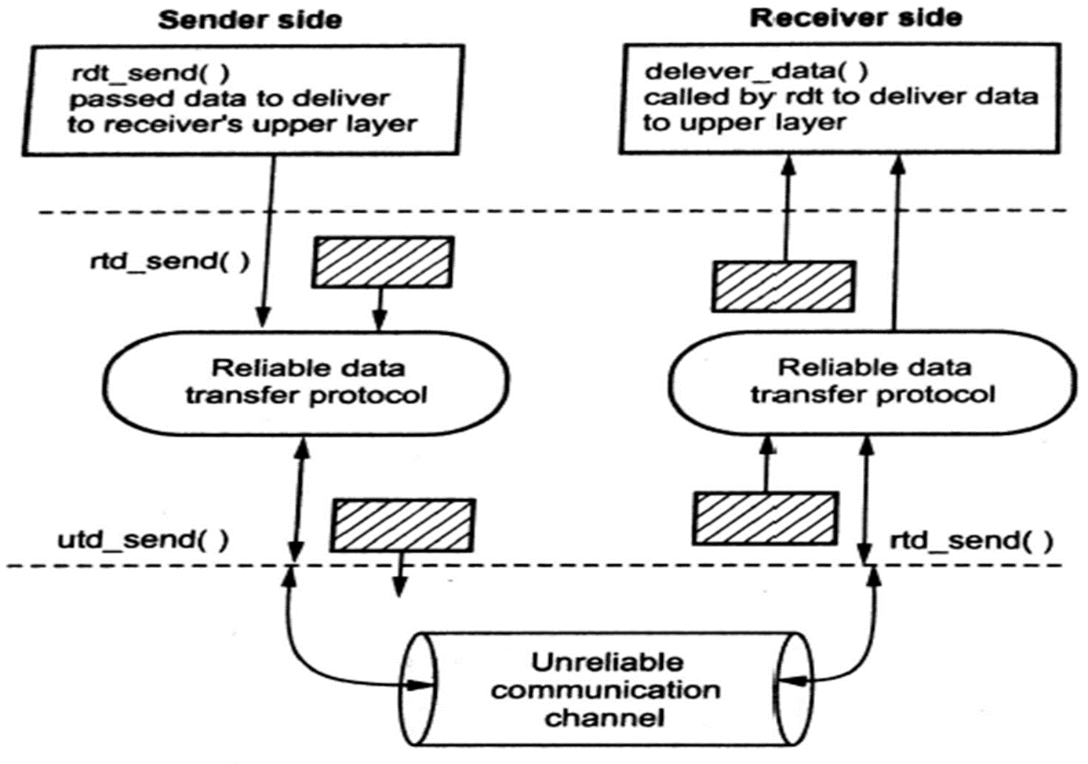
Principle of Reliable Data Transfer
Problem of reliable data transfer occurs at application, transport and data link layer.
Reliable data transfer means, data received without loss or corrupt.
All the packets are delivered in the order in which they were sent.
The complexity of the reliable data transfer protocol determined by characteristics of unreliable channel.
Figure shows reliable data transfer service model.
Figure: Rdt 2.0 Model

Slide 51
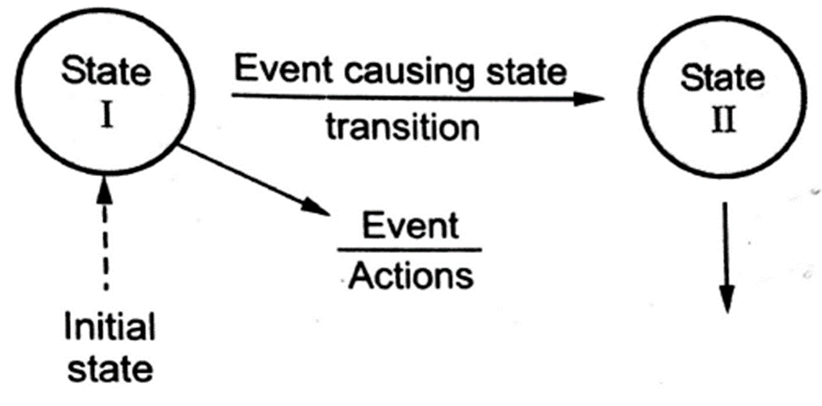
Principle of Reliable Data Transfer
Reliable Data Transfer Model (rdt 2.0)
Develop sender and receiver sides of reliable data transfer protocol. Here we consider only unidirectional data transfer. But the control information will flow in both direction.
The finite state machine is used for specifying sender and receiver. Figure shows Finite State Machine model.
State: When in this state, next state is uniquely determined by next event.

Slide 52
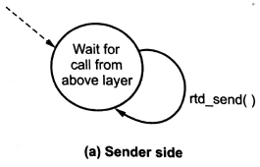
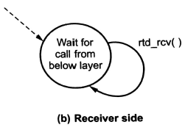
Principle of Reliable Data Transfer
Sender Side
It takes data from upper layer by using system call rdt_send (data). Then it creates packet which contains user data and sends the packets into the communication channel.
Receiver Side
In this side, receives a packet from the underlying communication channel via the rdt_rcv (packet) event. It receives the data from the packet and sends data up to the upper layer. All packet flow from sender to receiver.

Slide 53
Principle of Reliable Data Transfer
The underlying channel may flip bits in packets, so bit errors occur.
The protocols used for noiseless channel and noisy channel are as follows.
Noiseless channel protocols are
Simplest
Stop and wait
Noisy channel protocols
Stop and wait ARQ
Go back N ARQ
Selective repeat ARQ
Protocols in which the sender waits for a positive acknowledgement before advancing to the next data item are often called Positive Acknowledgement with Retransmission or Automatic Repeat Request (ARQ).
Notes:
Automatic Repeat Request (ARQ) is an error-control mechanism for data transmission which uses acknowledgements (or negative acknowledgements) and timeouts to achieve reliable data transmission over an unreliable communication link.

Slide 54
Sliding Window Protocol
Sliding Window Protocol
A sliding window protocol is a feature of packet-based data transmission protocols.
Sliding window protocols are used where reliable in-order delivery of packets is required, such as in the data link layer (OSI layer 2) as well as in the Transmission Control Protocol (TCP).
The sliding window is a technique for sending multiple frames at a time.
It controls the data packets between the two devices where reliable and gradual delivery of data frames is needed.
In this technique, each frame has sent from the sequence number. The sequence numbers are used to find the missing data in the receiver end.
The purpose of the sliding window technique is to avoid duplicate data, so it uses the sequence number.

Slide 55
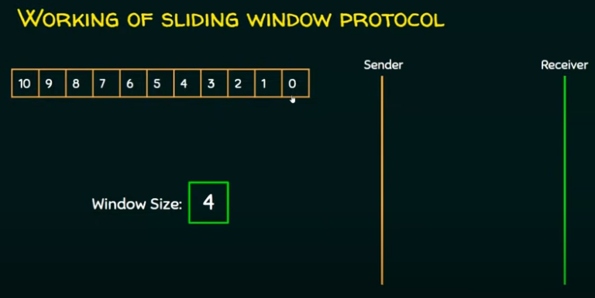
Sliding Window Protocol

Slide 56
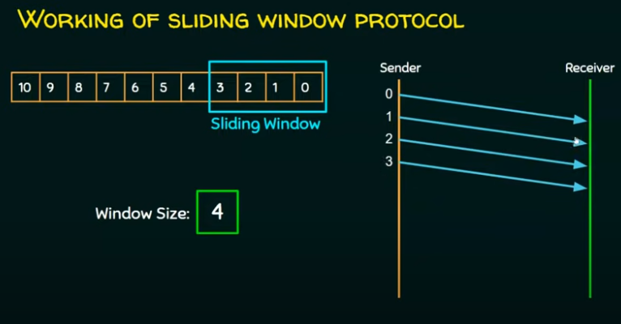
Sliding Window Protocol

Slide 57
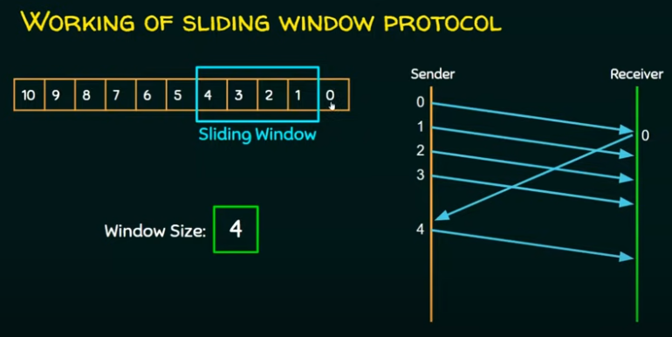
Sliding Window Protocol

Slide 58
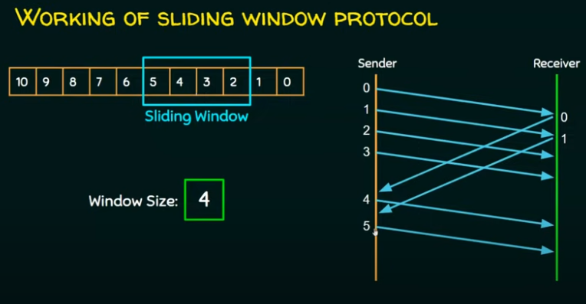
Sliding Window Protocol

Slide 59
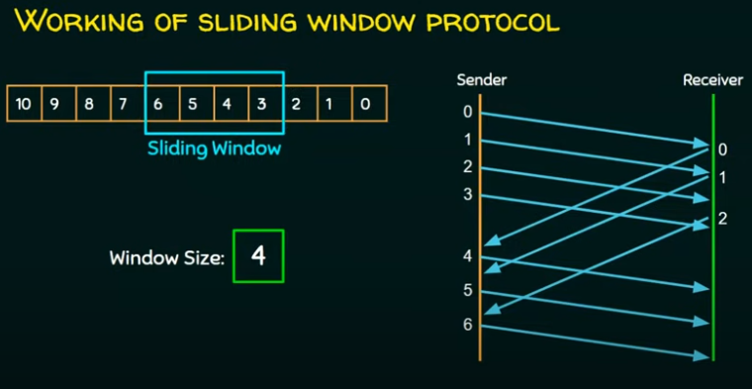
Sliding Window Protocol

Slide 60
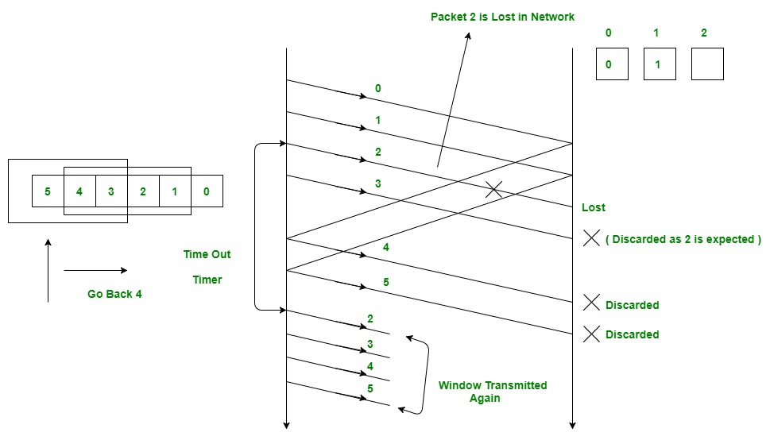
Go-back-N ARQ
Go – Back – N ARQ provides for sending multiple frames before receiving the acknowledgement for the first frame.
It uses the concept of sliding window, and so is also called sliding window protocol.
The frames are sequentially numbered and a finite number of frames are sent.
If the acknowledgement of a frame is not received within timeout period, all frames starting from that frame are retransmitted.

Slide 61
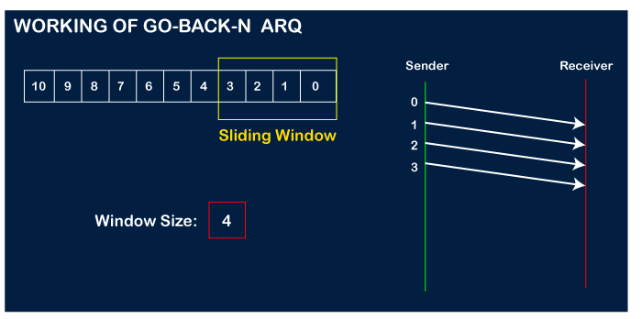
Go back N ARQ
Working of Go back N ARQ
Firstly, the sender will send the first four frames to the receiver, i.e., 0,1,2,3, and now the sender is expected to receive the acknowledgment of the 0th frame.

Slide 62
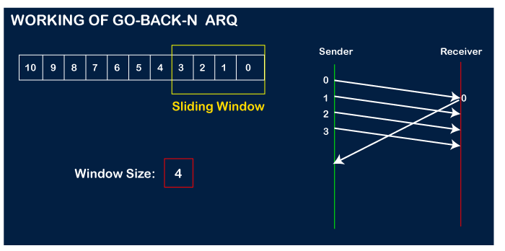
Go back N ARQ
Working of Go back N ARQ
Let's assume that the receiver has sent the acknowledgment for the 0 frame, and the receiver has successfully received it.

Slide 63
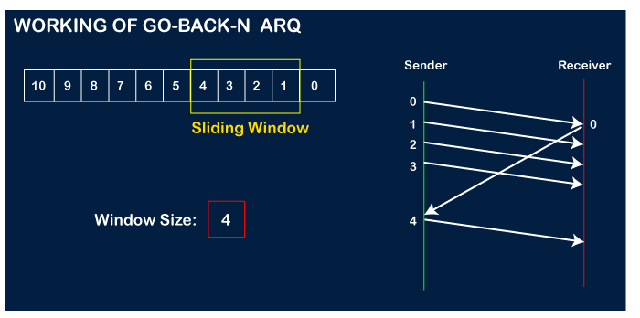
Go back N ARQ
Working of Go back N ARQ
The sender will then send the next frame, i.e., 4, and the window slides containing four frames (1,2,3,4).

Slide 64
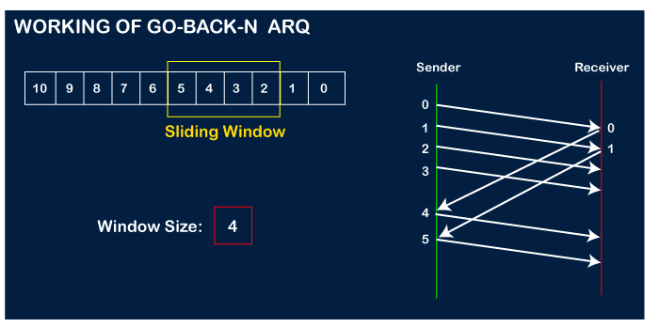
Go back N ARQ
Working of Go back N ARQ
The receiver will then send the acknowledgment for the frame no 1. After receiving the acknowledgment, the sender will send the next frame, i.e., frame no 5, and the window will slide having four frames (2,3,4,5).

Slide 65
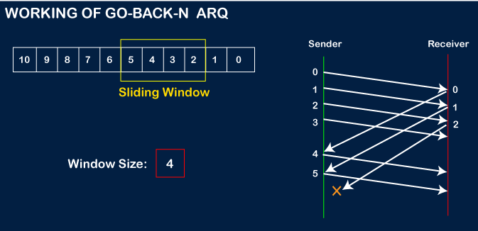
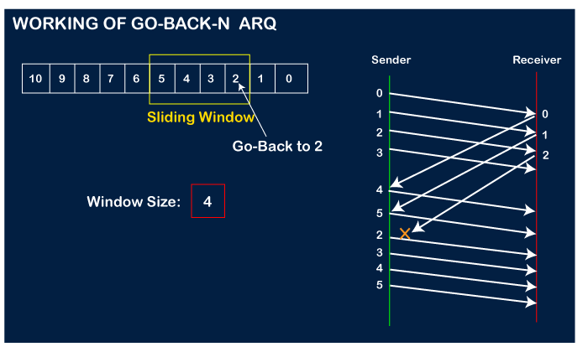
Go back N ARQ
Working of Go back N ARQ
Now, let's assume that the receiver is not acknowledging the frame no 2, either the frame is lost, or the acknowledgment is lost. Instead of sending the frame no 6, the sender Go-Back to 2, which is the first frame of the current window, retransmits all the frames in the current window, i.e., 2,3,4,5.

Slide 66
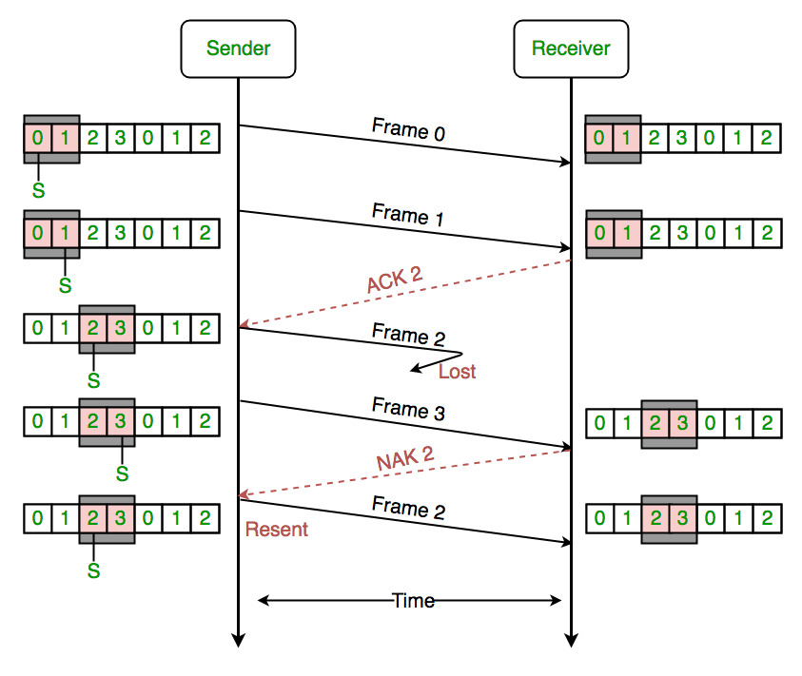
Selective Repeat ARQ
In the selective repeat, the sender sends several frames specified by a window size even without the need to wait for individual acknowledgement from the receiver as in Go-Back-N ARQ.
Selective Repeat ARQ also provides for sending multiple frames before receiving the acknowledgement for the first frame.
However, here only the erroneous or lost frames are retransmitted, while the good frames are received and buffered.
In selective repeat protocol, the retransmitted frame is received out of sequence.

Slide 67
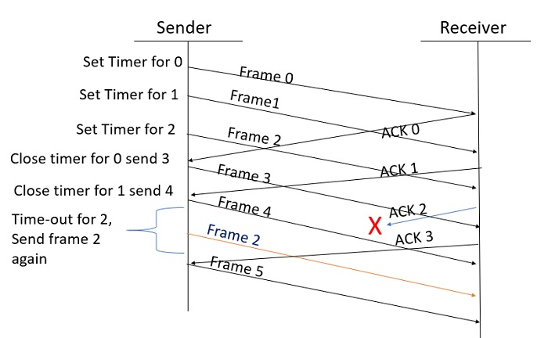
Selective Repeat ARQ
Example
Window Size = 3

Slide 68
Selective Repeat ARQ
Example
Step 1 − Frame 0 sends from sender to receiver and set timer.
Step 2 − Without waiting for acknowledgement from the receiver another frame, Frame1 is sent by sender by setting the timer for it.
Step 3 − In the same way frame2 is also sent to the receiver by setting the timer without waiting for previous acknowledgement.
Step 4 − Whenever sender receives the ACK0 from receiver, within the frame 0 timer then it is closed and sent to the next frame, frame 3.
Step 5 − whenever the sender receives the ACK1 from the receiver, within the frame 1 timer then it is closed and sent to the next frame, frame 4.
Step 6 − If the sender doesn’t receive the ACK2 from the receiver within the time slot, it declares timeout for frame 2 and resends the frame 2 again, because it thought the frame2 may be lost or damaged.

Slide 69
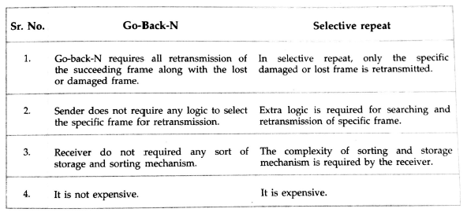
Selective Repeat ARQ vs GO-back-N ARQ

Slide 70
Flow Control

Slide 71
Flow Control
Flow control is a technique that allows two stations working at different speeds to communicate with each other.
It is a set of measures taken to regulate the amount of data that a sender sends so that a fast sender does not overwhelm a slow receiver.
In data link layer, flow control restricts the number of frames the sender can send before it waits for an acknowledgment from the receiver.

Slide 72
Flow Control
Approach of Flow Control
Flow control can be broadly classified into two categories −
Feedback based Flow Control In these protocols, the sender sends frames after it has received acknowledgments from the user. This is used in the data link layer.
Rate based Flow Control These protocols have built in mechanisms to restrict the rate of transmission of data without requiring acknowledgment from the receiver. This is used in the network layer and the transport layer.
Flow Control Techniques
Feedback-based Flow Control
Rate-based Flow Control

Slide 73
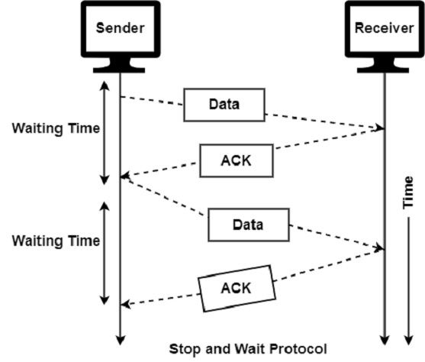
Flow Control
Stop and Wait Protocol
It is the simplest flow control method. In this, the sender will transmit one frame at a time to the receiver. The sender will stop and wait for the acknowledgement from the receiver.
This time (i.e. the time joining message transmitting and acknowledgement receiving) is the sender’s waiting time, and the sender is idle during this time.
When the sender gets the acknowledgement (ACK), it will send the next data packet to the receiver and wait for the disclosure again, and this process will continue as long as the sender has the data to send.

Slide 74
Flow Control
Stop and Wait Protocol
While sending the data from the sender to the receiver, the data flow needs to be controlled. If the sender is transmitting the data at a rate higher than the receiver can receive and process it, the data will get lost.
The Flow-control methods will help in ensuring that the data doesn't get lost. The flow control method will check that the senders send the data only at a rate that the receiver can receive and process.
The main advantage of stop & wait protocols is their accuracy. The next frame is transmitted only when the first frame is acknowledged. So there is no chance of the frame being lost.

Slide 75
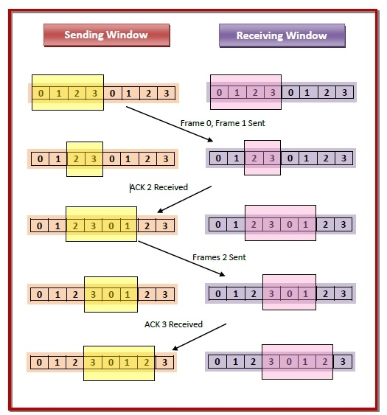
Flow Control
Sliding Window Protocol
The sliding window is a technique for sending multiple frames at a time. It controls the data packets between the two devices where reliable and gradual delivery of data frames is needed. It is also used in TCP (Transmission Control Protocol).
In this technique, each frame has sent from the sequence number. The sequence numbers are used to find the missing data in the receiver end. The purpose of the sliding window technique is to avoid duplicate data, so it uses the sequence number.

Slide 76
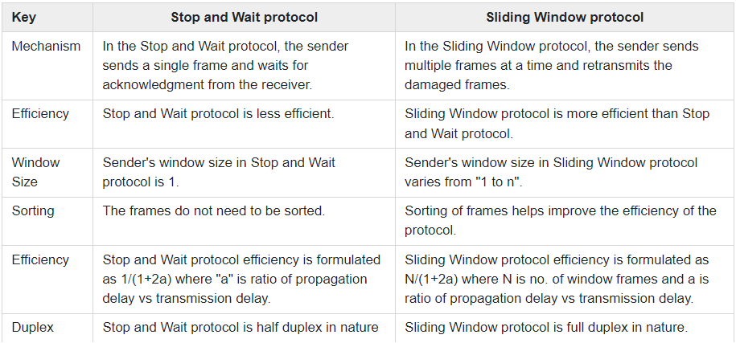
Stop-and-wait Protocol vs Sliding Window Protocol

Slide 77
Congestion Control

Slide 78
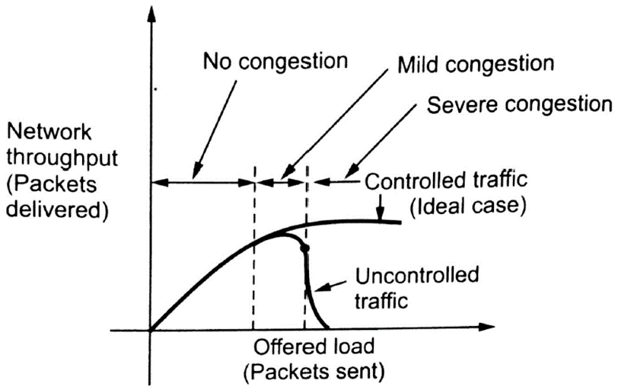
Congestion Control
Congestion Control: When too many packets rushing to a node or a part of network, the network performance degrades, and this situation is called as congestion.
Congestion control is different process than flow control.
The effect of congestion on throughput of a network shown in figure.
Notes:
https://www.youtube.com/watch?v=Ycy4VWr3-24

Slide 79
Congestion Control
Ideally as offered load increases, throughput also increases.
Practically throughput drops with increase in offered load because the buffers at each node’s are full and starts discarding packets.
Therefore, sources station must retransmits the discarded packets in addition with the new packets.
Under these circumstances, the network utilization and hence performance falls off.

Slide 80
Congestion Control
Cause of congestion:
At any node if all of a sudden streams of packets begin arriving on three or more links and all needed the same output link, there is a queue of packet for outgoing channel.
The other cause of congestion is slow processor speed. If the router’s CPU speed is slow and performing tasks like queuing buffers, table updating etc.
The bandwidth of the links are also important in congestion. The links to be used must be of high bandwidth to avoid the congestion.
When the arrival of the packets are not uniform i.e., when the traffic is bursty.

Slide 81
Congestion Control
General principles of congestion control:
It divides in two parts: Open loop and Closed loop
Open loop: Tools for doing open loop control include deciding when to accept new traffic, deciding when to discard packets and which ones, and making scheduling decisions at various points in the network.
Closed loop: This approach has three parts when applied to congestion control:
Monitor the system to detect when and where congestion occurs.
Pass this information to places where action can be taken.
Adjust system operation to correct the problem.

Slide 82
Congestion Control
TCP uses a form of end to end flow control.
Both the sender and the receiver agree on a common window size for packet flow
The window size represents the number of bytes that the source can send at a time.
The window size varies according to the condition of traffic in the network to avoid congestion.
TCP has main two congestion control method:
Additive increase
Slow start

Slide 83
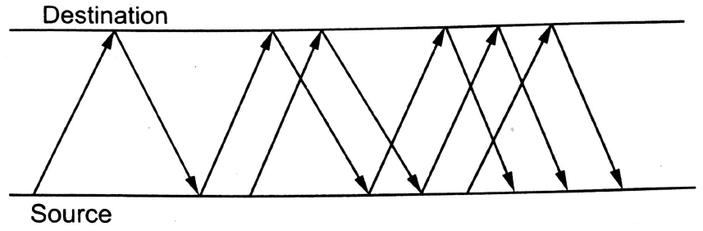
Congestion Control
Additive increase:
It is also known as additive increase, multiplicative decrease (AIMD).
TCP maintains a new variable for each connection, called congestion window, which is also used by the source to limit how much data it is allowed to have in transit at a given time.
The congestion window represents the amount of data, in bytes.
Figure shows the additive increase control for TCP congestion.

Slide 84
Congestion Control
Additive increase:
AIMD performs a slow increase in the congestion window size when the congestion in the network decreases and a fast drop in the window size when congestion increase.
The challenges in TCP congestion control is window size varies, based on traffic condition in the network.

Slide 85
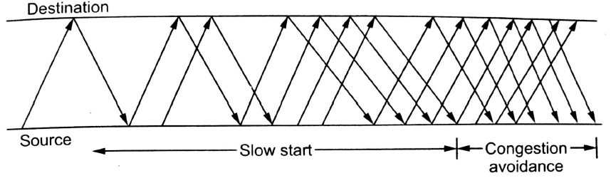
Congestion Control
Slow start method:
Slow start method increases the congestion window size non linearly and in most cases exponentially, as compared to the linear increase in additive increase.
Figure shows the slow start method. In this method, the congestion window is again interpreted in packets instead of bytes.

Slide 86
Congestion Control
Slow start method:
Source initially sets the congestion window to one packet. When its corresponding acknowledgement arrives, the source sets the congestion window to two packets.
Now, the source sends two packets. On receiving the two acknowledgements, TCP sets the congestion window size to 4.
The slow start method is normally used
Just after a TCP connection is setup.

Slide 87
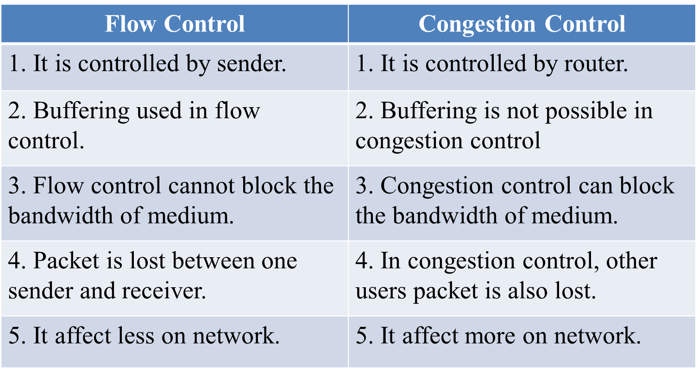
Flow Control vs Congestion Control

Slide 88

Thank
You

